Slide 1
BIOL4P05 Collector for ArcGIS
Sharon Janzen, MDGL

Slide 2
ArcGIS Online
Go to arcgis.com/home/signin.html
Sign in using the credentials sent to you
On your mobile device, download Collector for ArcGIS
You will be prompted to sign in using your ArcGIS Online credentials

Slide 3
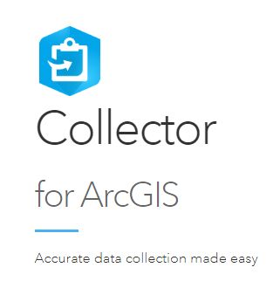
What is Collector for ArcGIS?
This mobile app is ideal for collecting data in the field then seamlessly integrate collected data to ArcGIS mapping software.

Slide 4
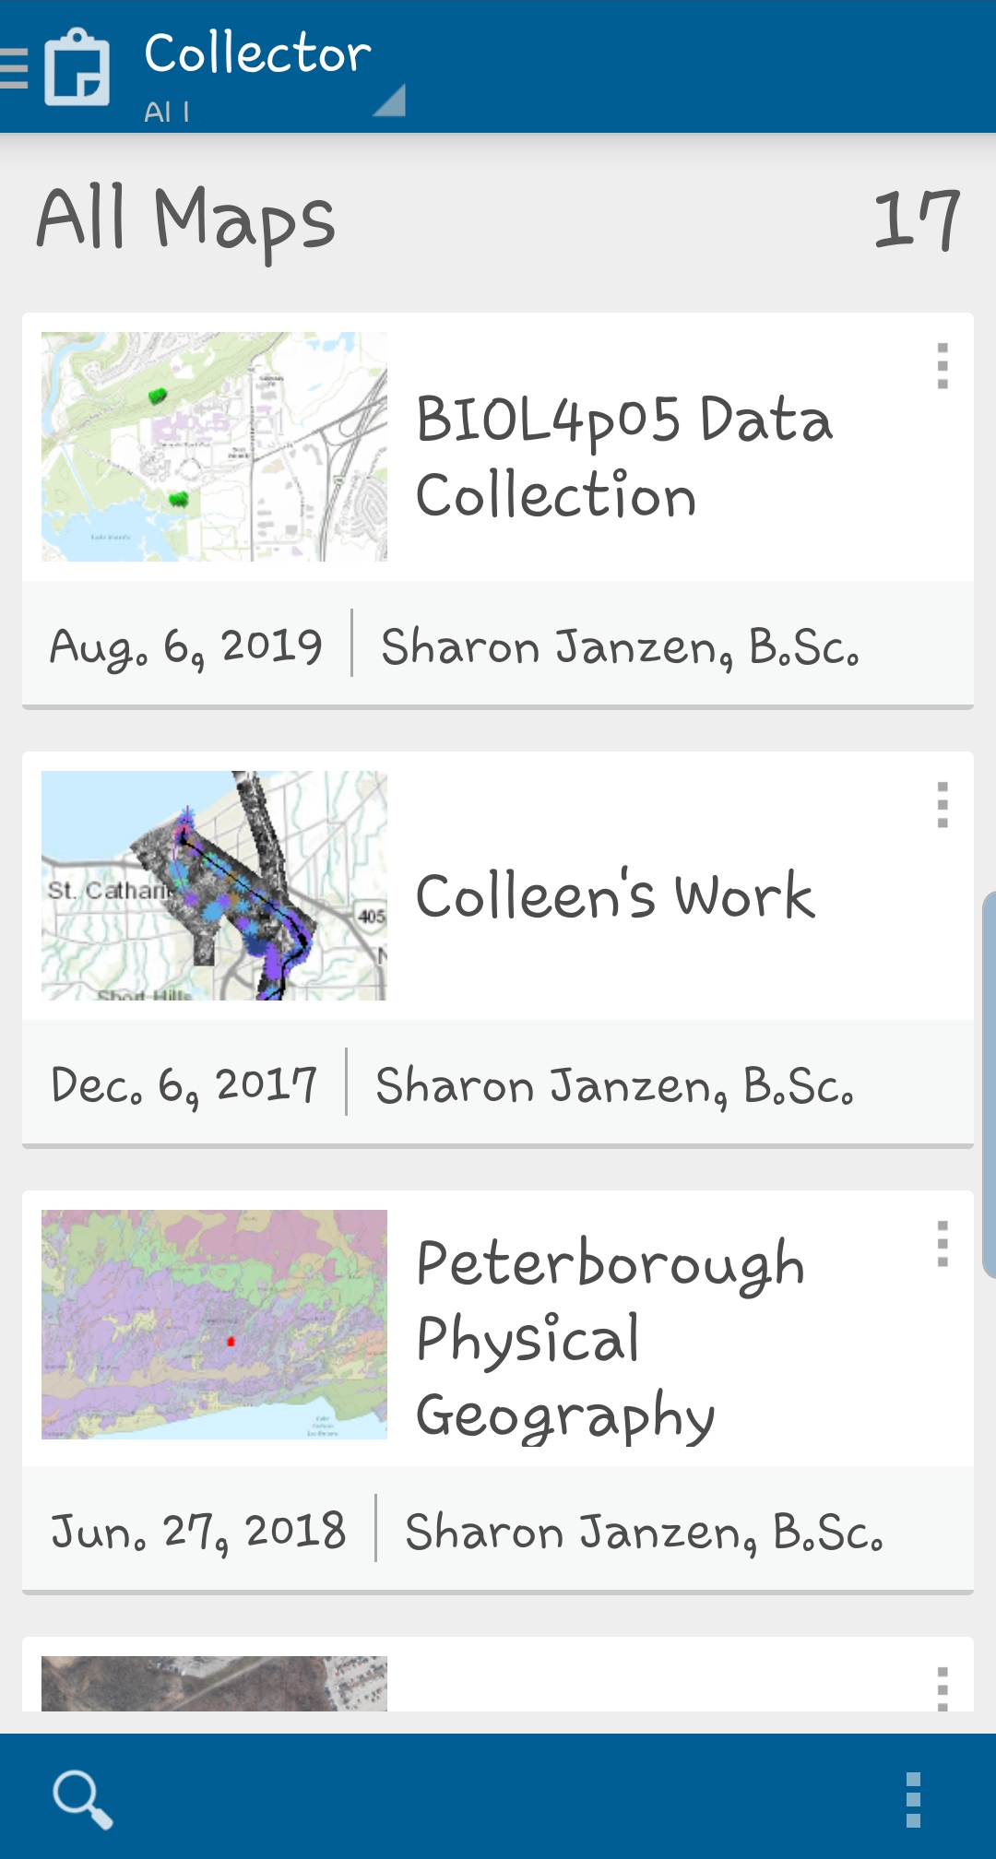

Slide 5
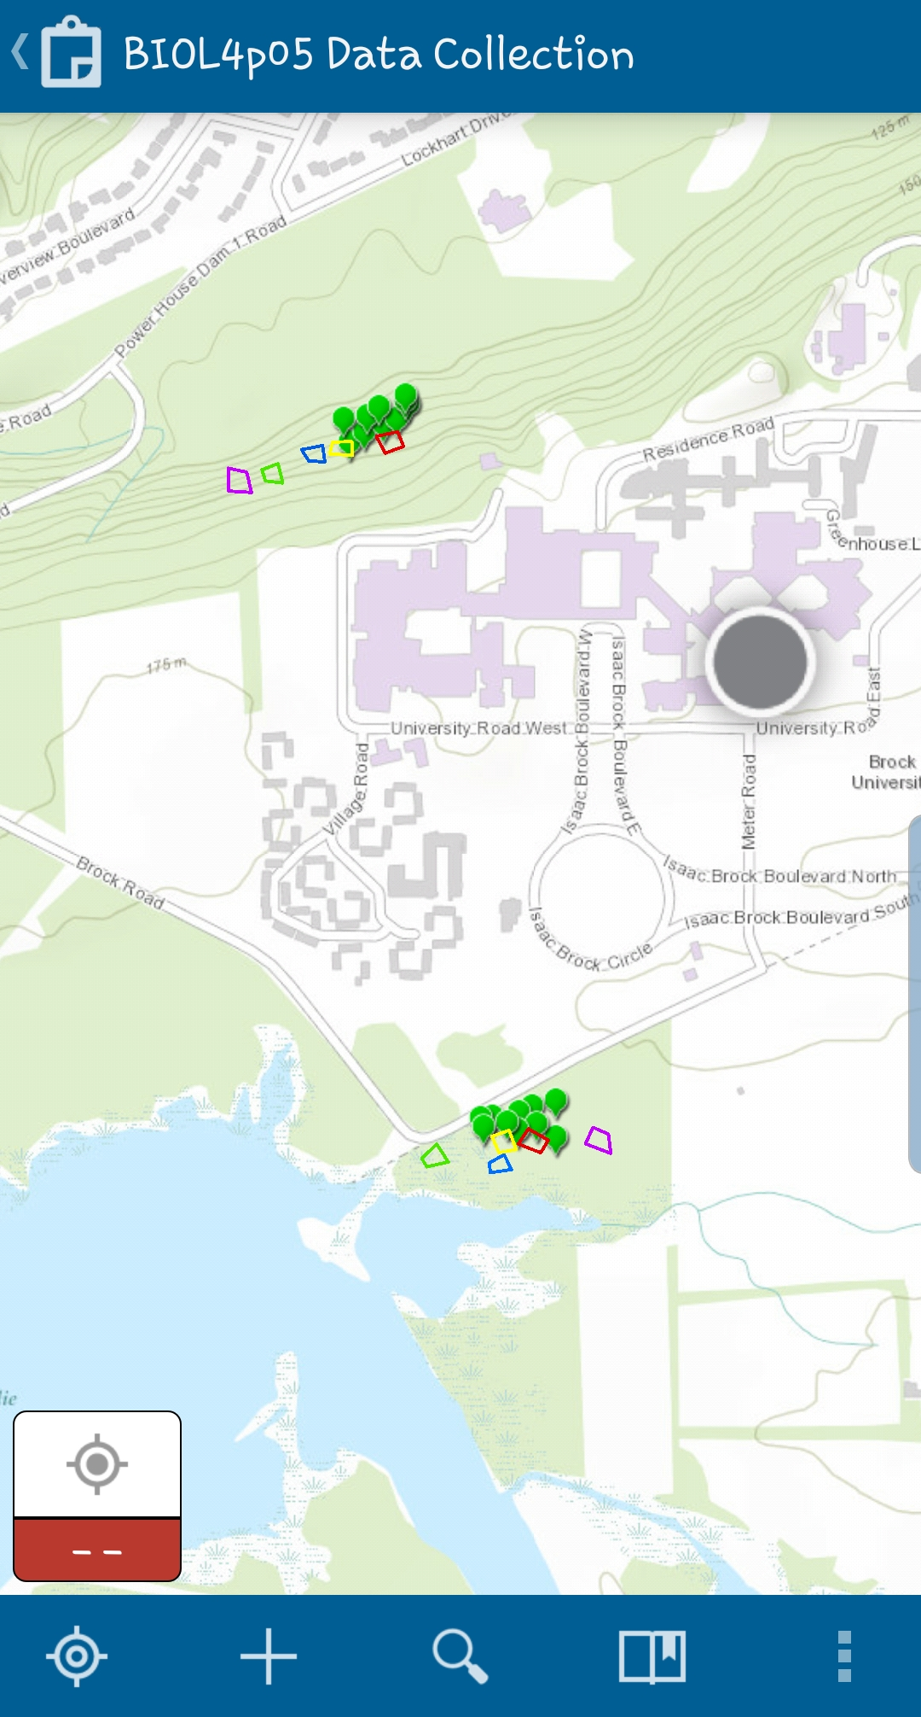
GPS location
Custom Map
Bookmarks

Slide 6
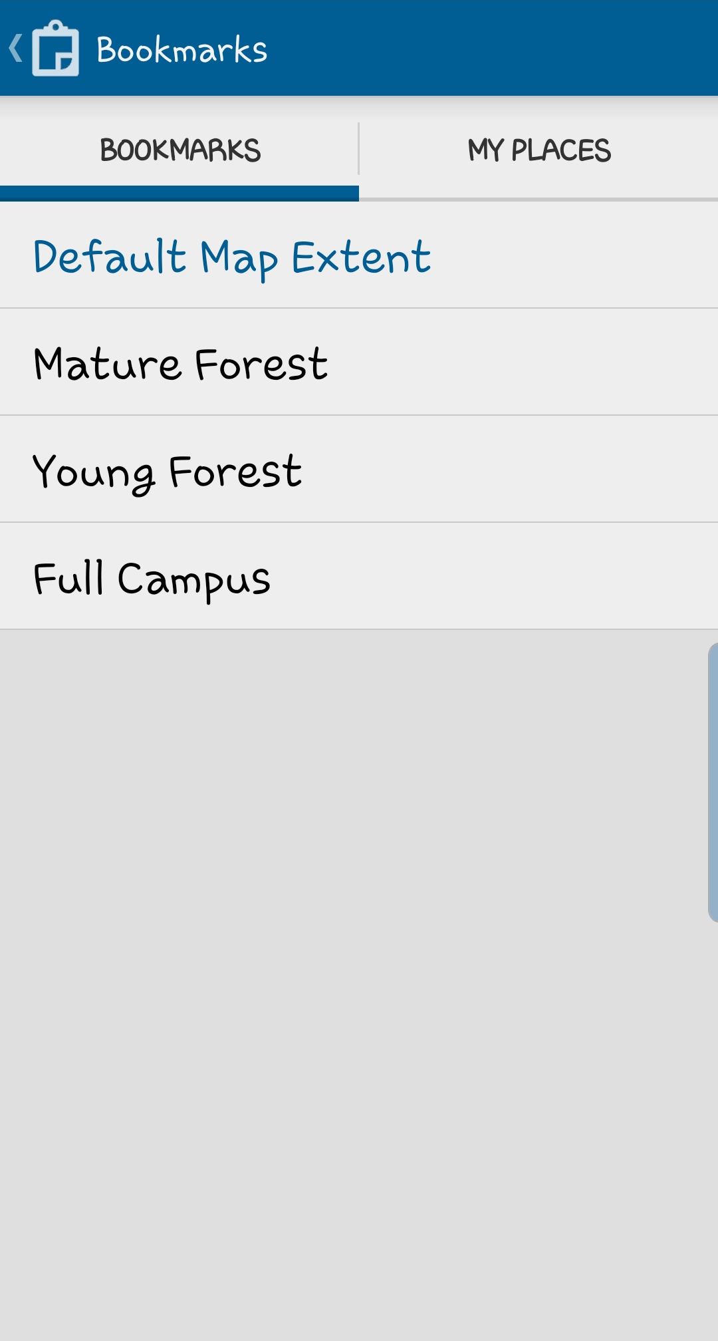
Tap bookmark

Slide 7
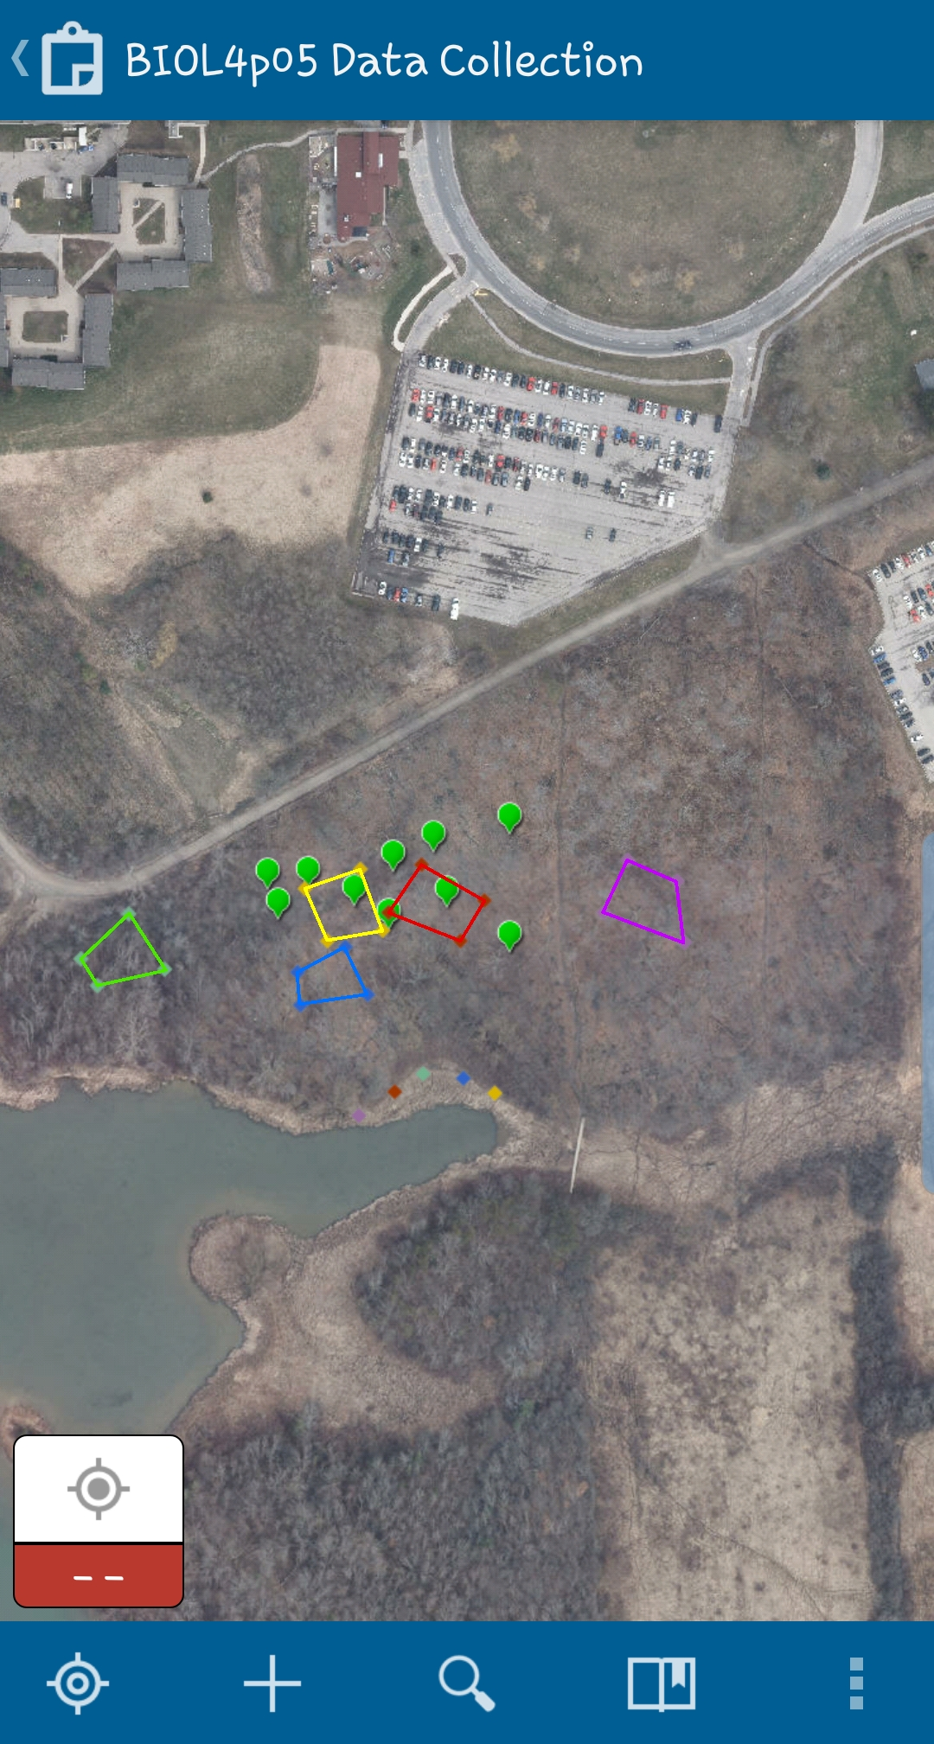

Slide 8
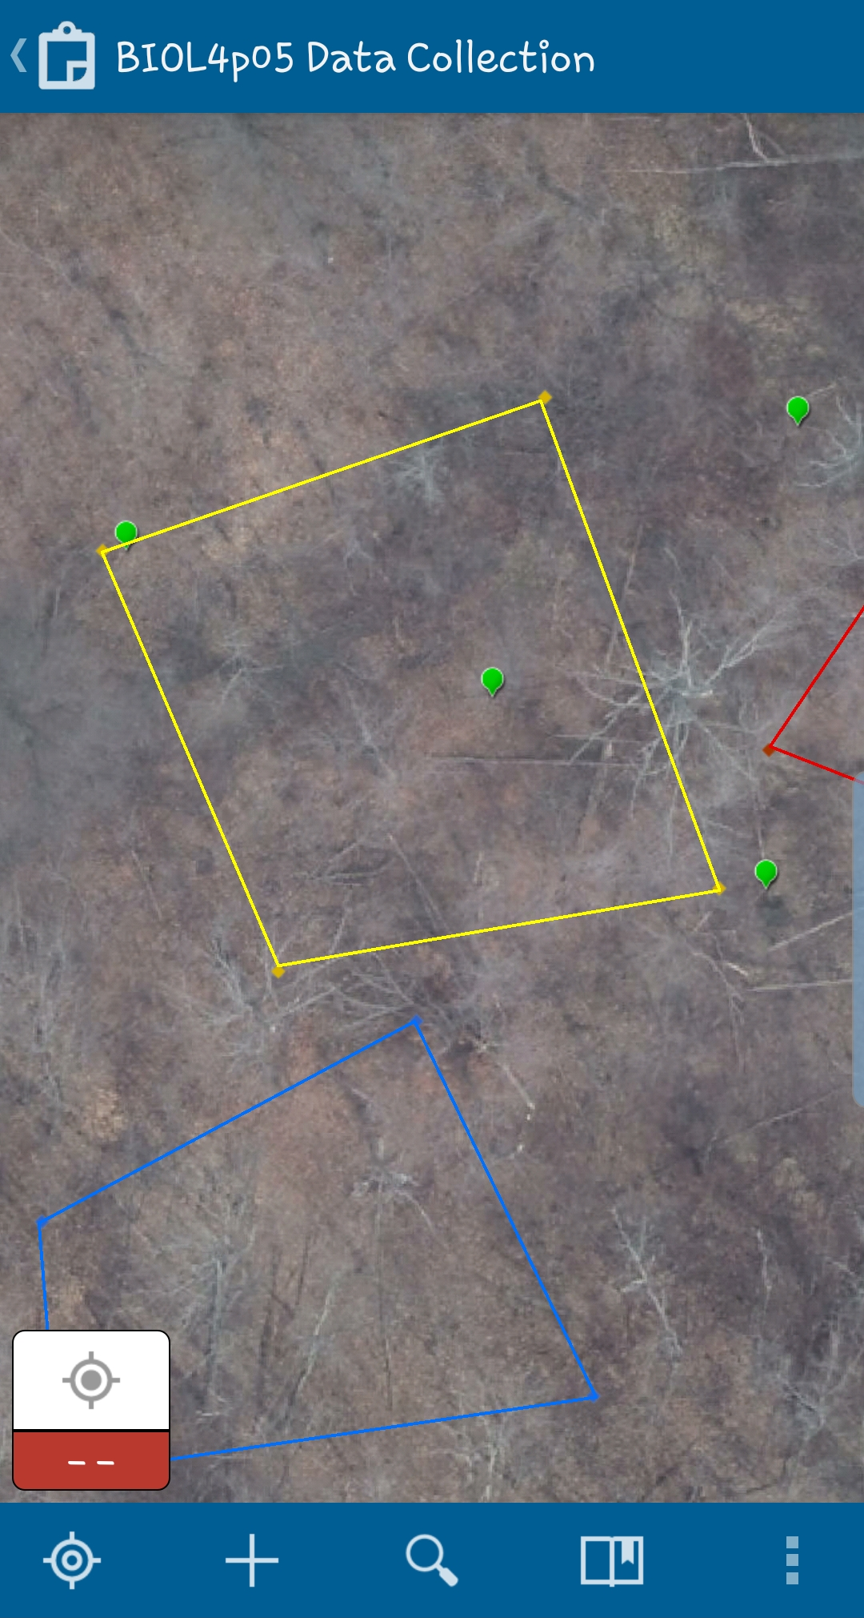
Zoom in by pinching
To add a feature,
Tap +

Slide 9
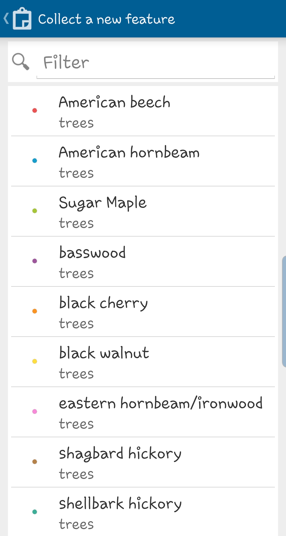
Select tree type

Slide 10
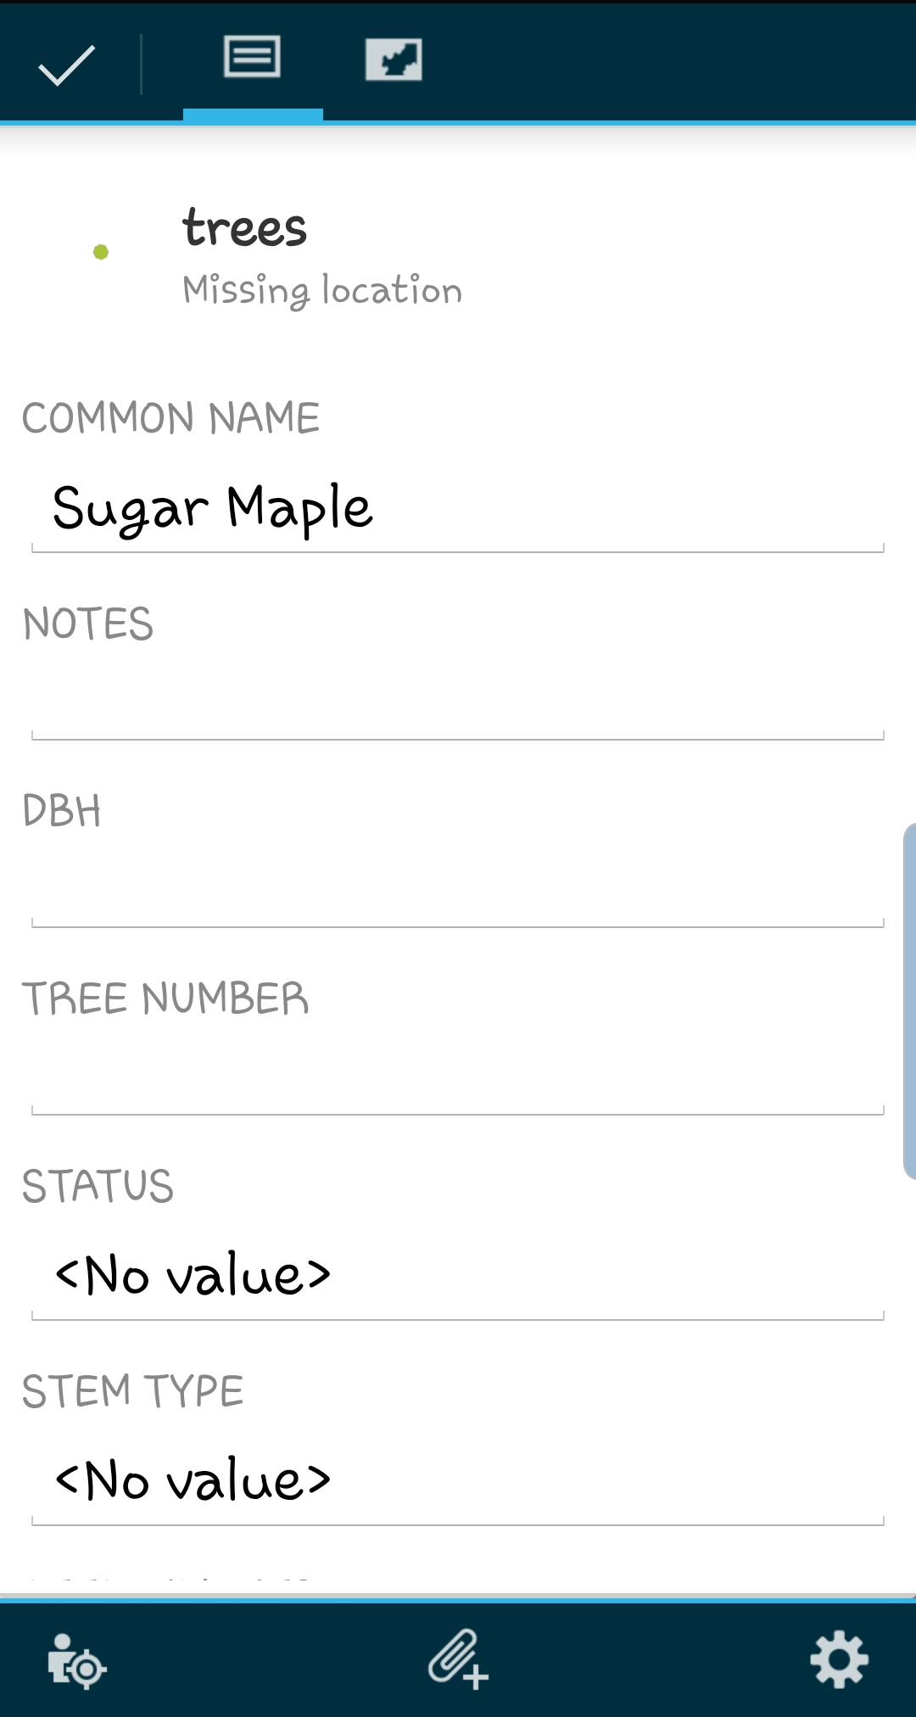
Enter values
To capture a photo,
Click paperclip

Slide 11
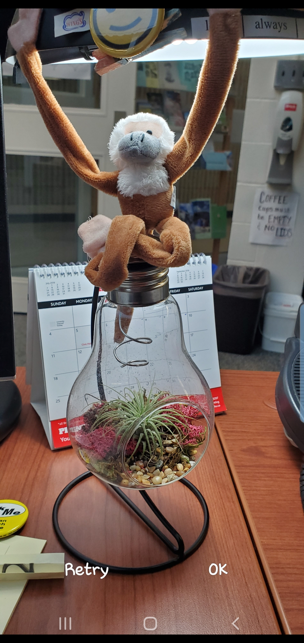
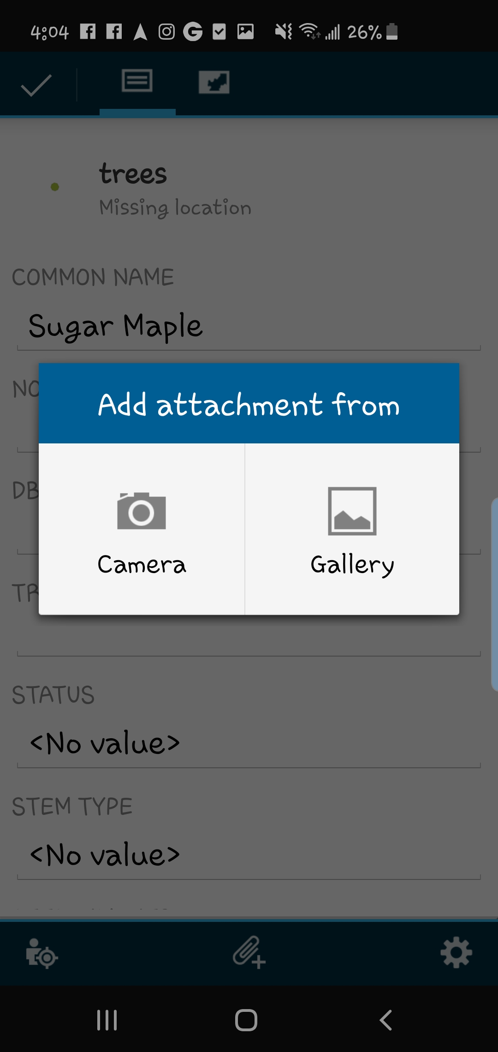
Tap Camera
Snap Photo,
Tap OK

Slide 12
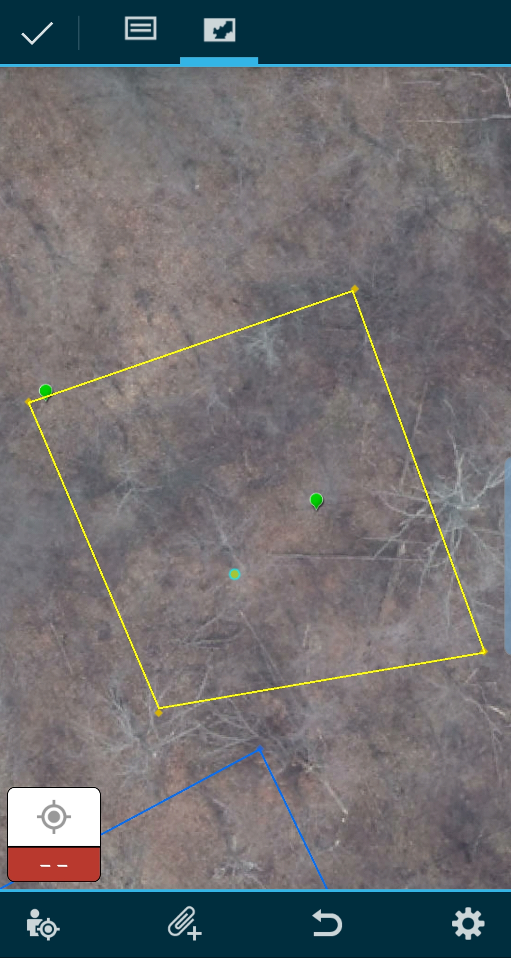
1. Tap map icon then
Zoom/pan or use GPS location
and tap to plot the point
2. Tap checkmark to finish

Slide 13
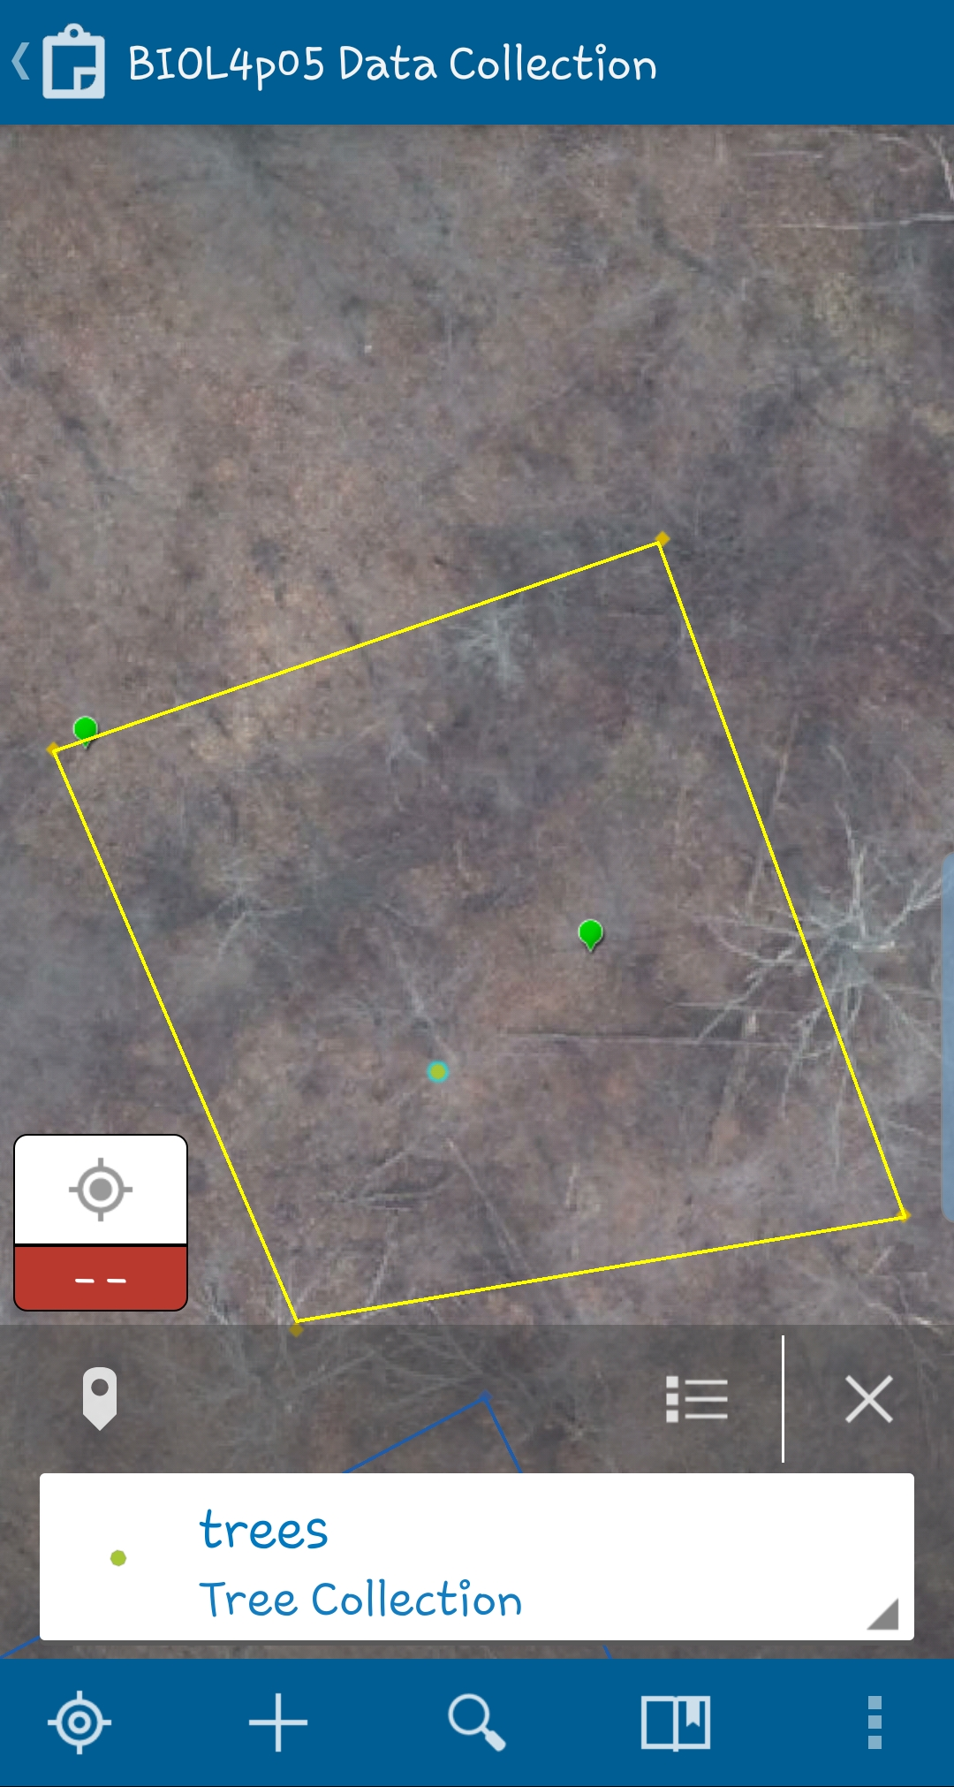
Tap here to see list of features
Tap here to edit/delete feature

Slide 14
Additional Reference Help
https://doc.arcgis.com/en/collector/iphone/help/quick-reference.htm
https://doc.arcgis.com/en/collector-classic/android/collect-data/quick-reference.htm
OR Google “Collector for ArcGIS quick reference”

